Slide 1
DEVELOPMENT AND APPLICATION OF CONCUSSION SENSORS
MEMS ACCELEROMETER
NAME:VASISHTA HD
SEMESTER:IV
USN NO:1RV13IT058

Slide 2
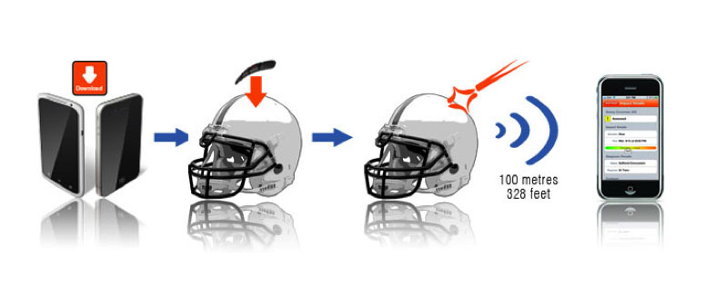
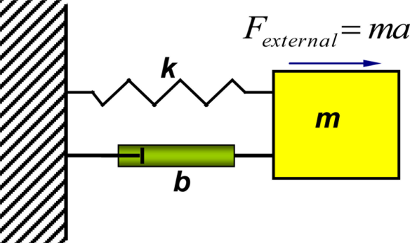

Slide 3
REFERENCE
Pearce JM (2007). "Observations on concussion. A review". European Neurology59 (3–4): 113–doi:10.1159/000111872. PMID 18057896.
Brooks D, Hunt B (2006). "Current concepts in concussion diagnosis and management in sports: A clinical review". BC Medical Journal 48 (9): 453–459. National Center for Injury Prevention and Control (2003). "Report to congress on mild traumatic brain injury in the United States: Steps to prevent a serious public health problem" (PDF). Atlanta, GA: Centers for Disease Control and Prevention. Retrieved2008-01-19. Petchprapai N, Winkelman C (2007). "Mild traumatic brain injury: determinants and subsequent quality of life. A review of the literature". Journal of Neuroscience Nursing39 (5): 260–72. doi:10.1097/01376517-200710000-00002. PMID 17966292.
Barth JT, Varney NR, Ruchinskas RA, Francis JP (1999). "Mild head injury: The new frontier in sports medicine". In Varney NR, Roberts RJ. The Evaluation and Treatment of Mild Traumatic Brain Injury. Hillsdale, New Jersey: Lawrence Erlbaum Associates. pp. 85–6. ISBN 0-8058-2394-8. Retrieved 2008-03-06. http://en.wikipedia.org/wiki/Concussion https://www.sparkfun.com/datasheets/Components/SMD/adxl335.pdf https://www.google.co.in/url?sa=t&rct=j&q=&esrc=s&source=web&cd=8&cad=rja&uact=8&sqi=2&ved=0CEgQFjAH&url=http%3A%2F%2Fwww.nlm.nih.gov%2Fmedlineplus%2Fconcussion.html&ei=dIjmVP3KJsfIuATCmIKIAg&usg=AFQjCNFIkNdTLM9HQKzUIqB9V3EeOQy0Mg https://www.google.co.in/url?sa=t&rct=j&q=&esrc=s&source=web&cd=11&cad=rja&uact=8&sqi=2&ved=0CFsQFjAK&url=http%3A%2F%2Fkidshealth.org%2Fteen%2Fsafety%2Ffirst_aid%2Fconcussions.html&ei=dIjmVP3KJsfIuATCmIKIAg&usg=AFQjCNFs2lDMhzVecY14F1QAqPoxu17Faw

